Slide 1
Chopper Controlled Dc Motors
Name
Institution of Affiliation
Professor
Date

Slide 2
I NTRODUCTION TO CHOPPER CONTROL OF DC MOTORS
At times the conversion of dc supply voltage to different levels is needed. For example in trolley buses or the subway cars and electric cars which have a fixed dc supply source.
For the speed of the above mentioned examples we need to convert fixed voltage to a variable voltage dc source

Slide 3
CONVERSION OF FIXED DC VOLTAGE SOURCE TO VARIABLE DC VOLTAGE
There are several ways of converting fixed voltage source to variable dc voltage. They are:
Resistance control
AC link Chopper (Inverter-Rectifier)
Motor- Generator Set (M-G Set)
Dc Chopper (DC to DC Power Converter)

Slide 4
1.Resistance Control
In this method we place a variable resistor between the load and voltage.
The disadvantage of this method is energy wastage and low efficiency because of different resistances of different values require different value of load currents from a given output voltage source.
This method is applicable in the installation of older traction.

Slide 5
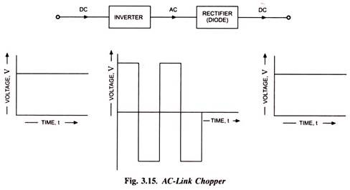
2. AC link Chopper (Inverter-Rectifier)
With AC link Chopper Inverter-Rectifier) the dc supply is converted to ac supply by an inverter. The converted ac supply is then stepped-up or stepped downed and then rectified back to dc supply by a rectifier.
This method is expensive bulky and has low efficiency, because of the set up of this method.

Slide 6
3.Motor- Generator Set (M-G Set)
When a dc generator is excited separately it provides a voltage that can be varied from zero to a rated value with either polarity.
This method is costly, bulky, has low efficiency and has low response because of the generator field is constant.

Slide 7
4. Dc Chopper (DC to DC Power Converter)
In this method, a static switch that provides variable dc voltage from a constant dc voltage source is used. This switch is known as the DC Chopper.
The dc chopper are now being used in transit systems all over the world.
Example of their applications are trolley cars, forklifts, in electric cars for speed control and braking and mine haulers.
Dc choppers are:-
  smooth control,
  high efficiency
  Fast in response and regeneration

Slide 8
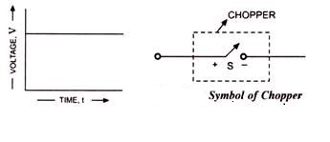
Principle of operation of chopper
The dc chopper is a high speed on /off semiconductor switch that connects and disconnects the load from the supply. It produces varying load voltage from a constant input supply voltage.
below Symbolic representation of the switch S inside a dotted rectangle
For low power chopper circuits, power transistor and GTOs are widely used while in high power circuits thyristors are commonly used. In the elementary chopper circuit, the switch is closed or opened (turned on/off) by sending an on/off pulse to it.

Slide 9
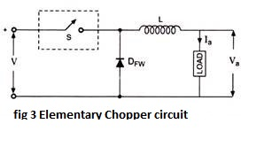
Principle of operation of chopper
In the figure 3,below the mechanism of sending on/off pulses is not shown. A shunting diode D_{FW} is provided across the load for the freewheeling the load current when the switch S is off. when the switch S is closed, the source voltage V, assuming the voltage across switch S in on-state is negligible, appears across the load for the duration the switch is closed. This duration is denoted as T_{on} .

Slide 10
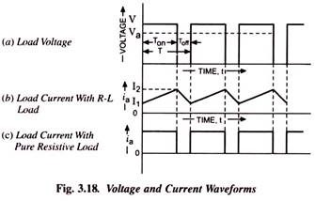
Principle of operation of chopper
After removing the pulse to switch the load is disconnected from the source. The energized inductor circulates a current through the freewheeling diode D_{FW} . This a short circuits the load and the voltage across it falls to zero and the current through the load falls exponentially, as shown below in fig 3.18The duration for which the switch is off is called Off time T_{off} . The total time of pulse is therefore given by
T = T_{on} + T_{off.}

Slide 11
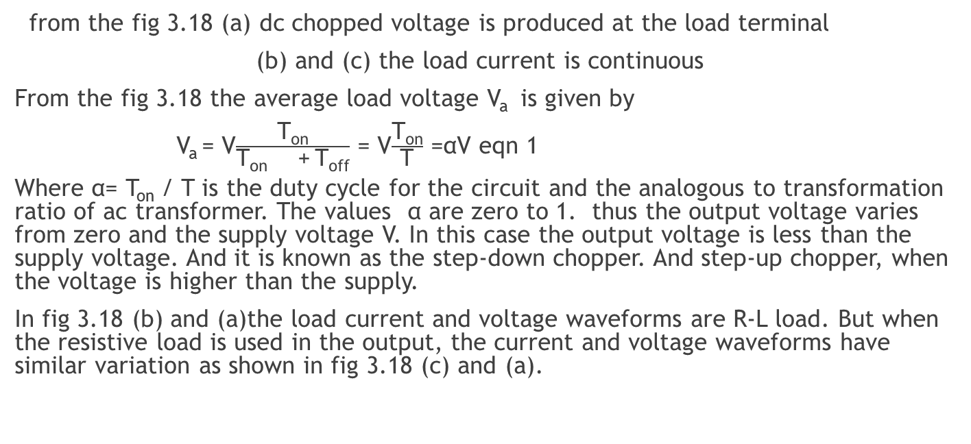
Principle of operation of chopper
from the fig 3.18 (a) dc chopped voltage is produced at the load terminal
(b) and (c) the load current is continuous
From the fig 3.18 the average load voltage V_{a} is given by
V_{a} = V$\frac{\text{T}\text{on}}{\text{T}\text{on}\text{ +} \text{T}\text{off}}$ = V$\frac{\text{T}\text{on}}{\text{T}}$ =αV eqn 1
Where α= T_{on} / T is the duty cycle for the circuit and the analogous to transformation ratio of ac transformer. The values α are zero to 1. thus the output voltage varies from zero and the supply voltage V. In this case the output voltage is less than the supply voltage. And it is known as the step-down chopper. And step-up chopper, when the voltage is higher than the supply.
In fig 3.18 (b) and (a)the load current and voltage waveforms are R-L load. But when the resistive load is used in the output, the current and voltage waveforms have similar variation as shown in fig 3.18 (c) and (a).

Slide 12
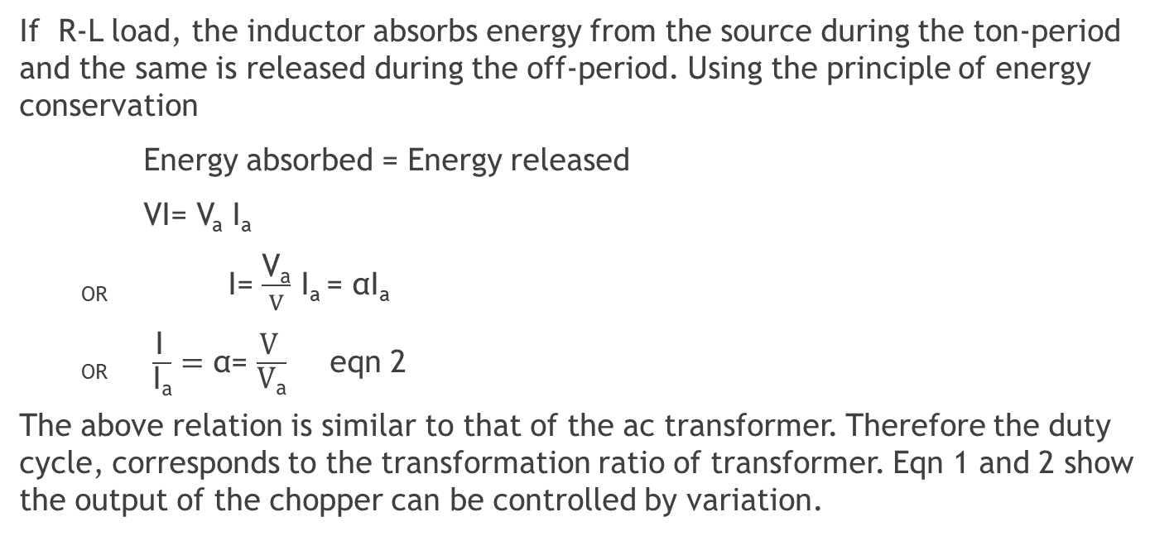
Principle of operation of chopper
If R-L load, the inductor absorbs energy from the source during the ton-period and the same is released during the off-period. Using the principle of energy conservation
Energy absorbed = Energy released
VI= V_{a} I_{a}
_{OR} I= $\frac{\text{V}\text{a}}{V}$ I_{a} = αI_{a}
_{OR} $\frac{\text{I} }{\text{I}\text{a}}=$ α= $\frac{\text{V} }{\text{V}\text{a}}$ eqn 2
The above relation is similar to that of the ac transformer. Therefore the duty cycle, corresponds to the transformation ratio of transformer. Eqn 1 and 2 show the output of the chopper can be controlled by variation.

Slide 13
Control strategies
From eqn 1 the average value of the output voltage, V can be controlled by periodic opening and closing of the semiconductor switch. There are two control strategies used which are:
  Time-ratio control (TRC)
  Current limit control
  Time- ratio control (TRC)
  In TRC, the value T_{on} / T of is varied. And its because variable frequency control and constant frequency control are affected.
  a) Variable Frequency Control (FM)
  In FM the chopping frequency is kept variable and for this purpose the on time or the off time is kept constant. Therefore this scheme is called the Frequency Modulation (FM).
  b) Constant Frequency Control
  in this scheme the chopping time remains constant but the pulse width is varied to control the output. This scheme is called the Pulse With Modulation

Slide 14
Control strategies
  The disadvantage of variable frequency control
  It experiences wide range of harmonic which are hard to remove
  It has large period of duty cycle that leads to load current falling to zero between two consecutive pulses
  For control of duty cycle the frequency variations would be wide.
  Due to the above reasons the pulse width modulation control is preferred over the FM control chopper circuit.
  2. Current Limit Control
  In this scheme the chopper is switched on and off between upper and lower limits of load current . when the load current exceeds upper limit the chopper is turned off. The load current freewheels until it reaches the lower value set. As the current attains lower limit, the chopper is switched on.

Slide 15
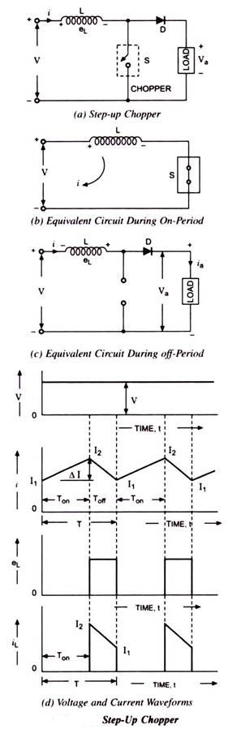
Step-Up Chopper
In this choppers the output voltage is higher than the supply voltage. In this chopper an inductor is connected in series with the supply voltage source.
When the chopper is on, the current flows through inductance L, the chopper S and power supply source. During the on- period the T_{on, the} inductor L store energy. The set up is shown below
v

Slide 16
Step-Up Chopper
When the chopper is off, the inductor current is forced to flow through the diode and load for a period T_{off} because the inductor current discharges slowly. As current decreases the polarity of the emf induced in the inductor is reverse.
Energy stored in T_{on} the inductor is given by:
W_{I} = V × I_{a} × T_{on}
A cycle average value of current is given by:
I_{a} = I₁ ₊I₂/2 × T_{on}
W_{I} = V× I₁ ₊I₂/2 × T_{on}
Energy released in T_{off} the inductor is given by:

Slide 17

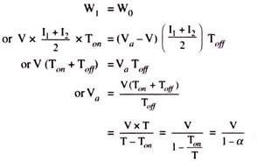
Step-Up Chopper
W_{O} =Voltage across inductor × average current through inductor × T_{off}
Assume the system to be lossless then:

Slide 18
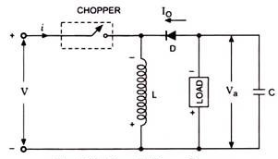
Step-Up/Down Chopper
This chopper can be used to step up or down the supply voltage by varying its duty cycle. Its operation is as shown below

Slide 19

Step-Up/Down Chopper
When the chopper is on, the supply current flows through path V+ ,chopper, inductor L and V-. This energizes the inductor to store energy. When the chopper is off the energy in the inductor decreases. This results in in the reversion of the load polarity w.r.t. source voltage as stored energy in the inductor is released from the inductor through the load, diode and the voltage across the load.
Energy stored in the inductor L at T_{on}
W_{I} =v × I_{a} × T_{on}
Average current I_{a} through the inductor L

Slide 20

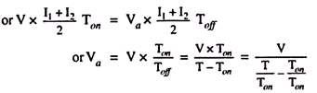
Step-Up/Down Chopper
Energy released by the inductor is given by:
In stead state on energy losses thus
W_{I} = W_{O}
_{Therefore}

Slide 21

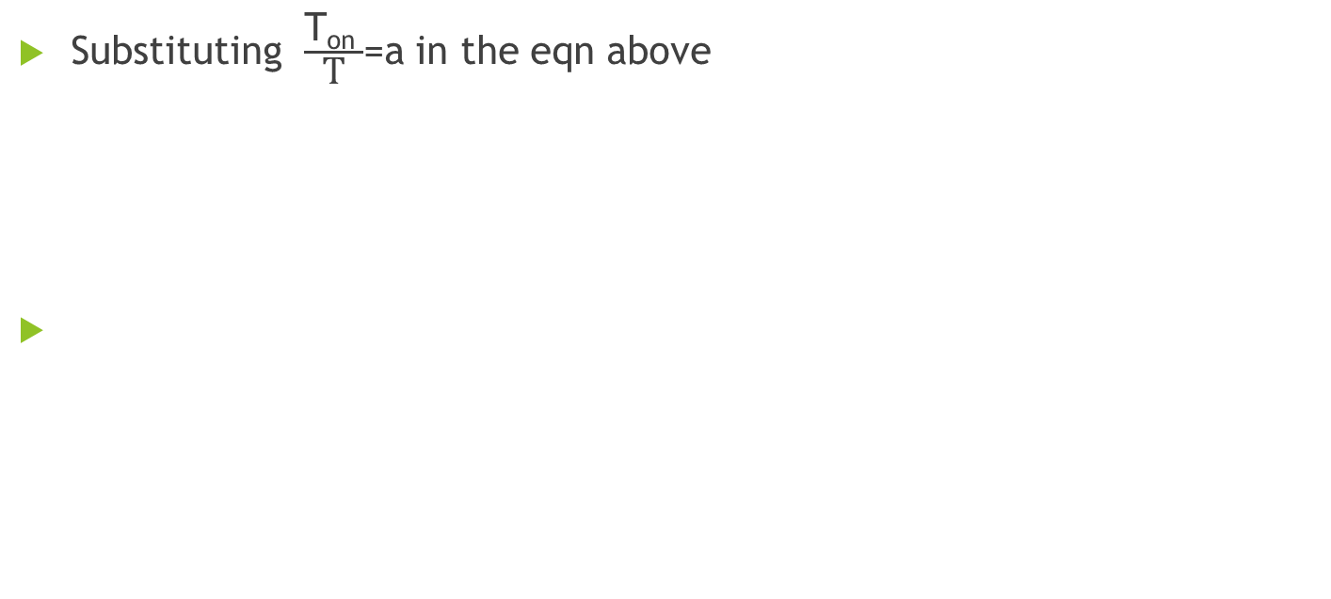
Step-Up/Down Chopper
Substituting $\frac{\text{T}\text{on} }{\text{T}}$=a in the eqn above

Slide 22
Chopper Control of Separately Excited DC Motor Drive
There are three modes of operating chopper drivers and they are:
  Motoring mode
  Regenerative braking mode
  Rheostatic braking mode
  1. Motoring mode
  In this mode one quadrant chopper feeds the motor from a dc supply of voltage, the field being excited is separated from a separate source. When the chopper conducts, voltage across the motor armature is supply voltage, and when it blocks, voltage across the armature is zero. Since both average voltage and current are positive, power can flow to the load from the source. This represent motoring operation.
  2. Regenerative braking mode
  In this mode braking the motor is made to operate as a generator and the kinetic energy of the motor is converted to electrical energy and returned to the supply.

Slide 23
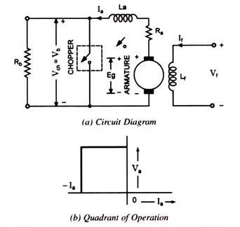
Chopper Control of Separately Excited DC Motor Drive
  3. Rheostatic braking mode
  This mode is the motor also operates as a generator and the kinetic energy converted to electrical energy. The electrical energy is generated in the braking resistance connected to the terminals as shown below.

Slide 24
References
S Arof, NHN Diyanah, NM Noor, JA Jalil -Progress in Engineering, 2019 – Springe
R Nagarajan, S Sathishkumar, S Deepika - Engineering And, 2017
M Moradi - Journal of Solid and Fluid Mechanics, 2020
A Narendra, NV Naik, N Tiwary - 2018 IEEE 8th Power India, 2018
S Khubalkar, A Junghare, M Aware - Conference (ITEC-India, 2017

